Slide 1
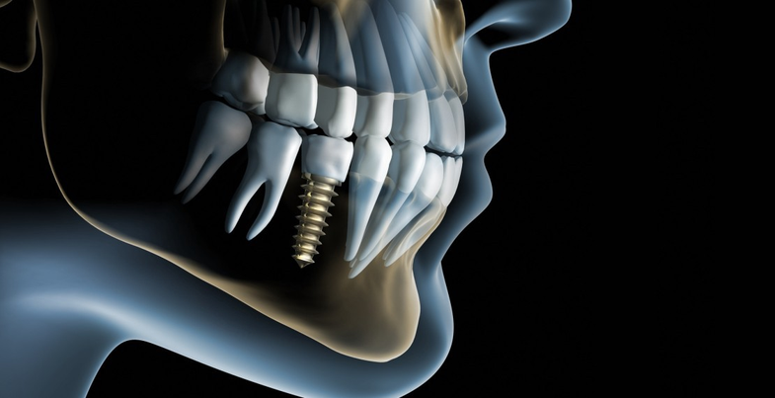
The challenging scenarios of dental implantology
Presented by: Daniel Zhelev and Peter Chantov

Slide 2
Introduction
Dental implantology is a dynamic science that practitioners are relying on for oral rehabilitation. Due to the higher success rate, dental care is turning more and more toward using implant-based oral prosthetics.

Slide 3
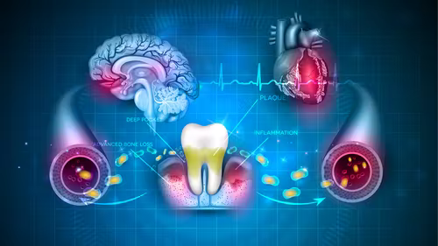
Patient-related factors
Anxiety
Allergy
Smoke history
Anatomical variations
Implant site local challenges
Local bone type
Local topography
The personal preference
Time frame demand

Slide 4
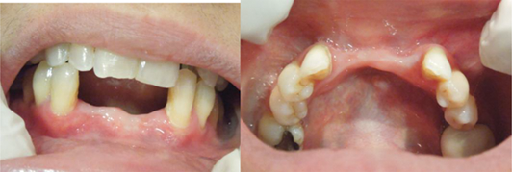
Surgical site alveolar deficiency
Intraoral clinical images showing bone deficiency at the vertical and horizontal levels leading to minimal gingival recession pertinent to the lower canine teeth.

Slide 5
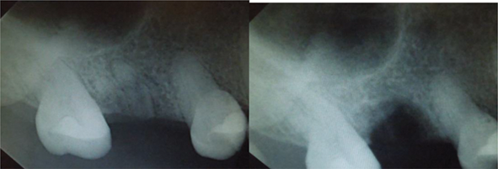
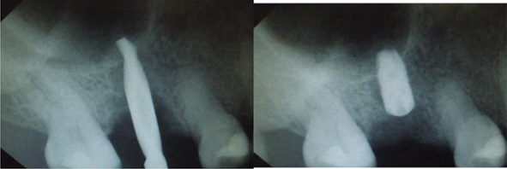
A periapical radiograph showing remaining roots of a previously attempted dental extraction
Accomplished implant placement

Slide 6
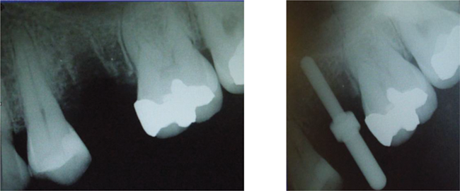
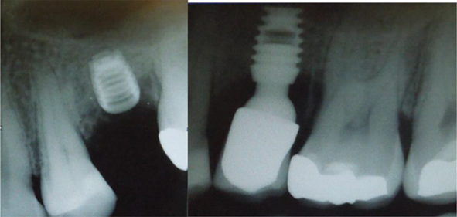
A radiograph of a 50-year-old patient showing limited vertical bone height to place dental implant.
A periapical radiograph showing the short implant in situ and the crown placed in favorable status.

Slide 7
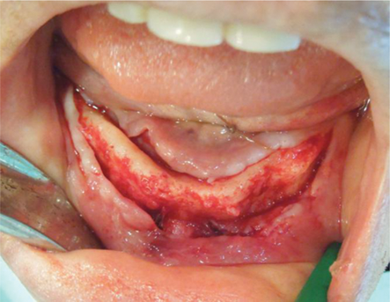
Local blood supply deficiency
Sometimes, missing to identify cortical areas of poor blood perforates, especially in older patients, can be the reason behind the success or failure.

Slide 8
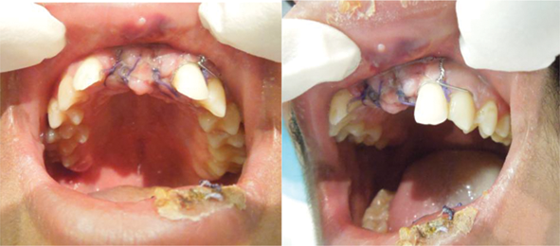
A 75-year-old female patient who was known to be diabetic that is controlled and followed by an endocrinologist. The clinical image shows alveolar bone local limited blood supply at the crestal level when compared to the buccal plate perforates.

Slide 9
Operator-related factors
Expertise
Training background
Operator’s capabilities
Personal interest to introduce new techniques
Knowledge of data interpretation
The presence of a supporting team
The talent to adjust with the challenging case requirement

Slide 10
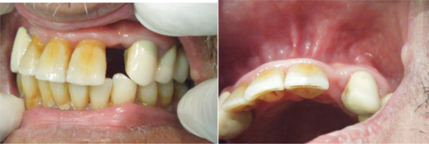
Narrow dental implant
In locations of limited mesiodistal width, the ability to place an implant can be jeopardized by a lot of factors, such as the flap design, root angulation, coronal tilting, alveolar bone dimension, and operator’s clinical skills to place an implant usually via one or two drilling sequences only, which can leave no room for corrections neither over preparation of osteotomy sites.

Slide 11
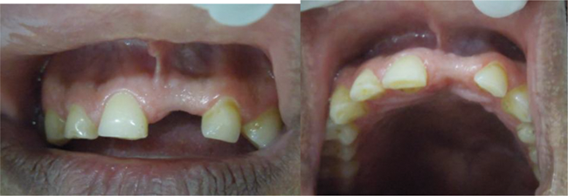
The challenge of onlay bone grafting
A 33-year-old male patient presented with missing left central incisor for more than 6 years secondary to trauma.

Slide 12
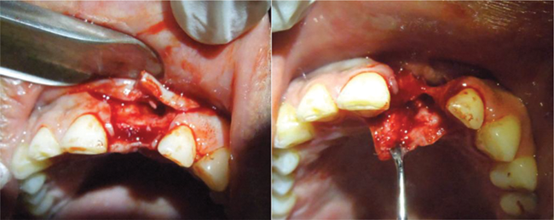
A clinical intraoperative image of the previous case showing the flap raised and indicating an extremely poor alveolar bone horizontal width that prohibits the implant placement and switch the procedure to a local grafting using particulate allogenic graft with calcium sulfate carrier to improve the consistency and bulk.

Slide 13
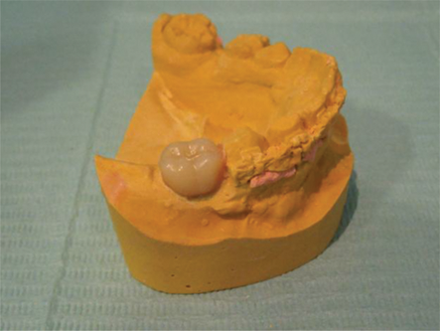
Material-related factors
Implant surface type
Length, diameter
Internal design
External design
Laboratory capabilities
Managing challenges
Images capabilities
Surgical stents
Radiographic imaging
Cone beam CT scanning
The proficiency to manage the time factor

Slide 14
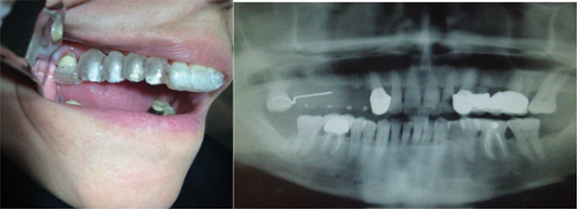
This case is planned for multiple dental implants in the upper right maxillary region using surgical stent that was reviewed in the lab by a prosthetic team.

Slide 15
Dental wax-up and surgical stent fabrication
The dental wax-up is a necessary tool used to plan dental implant treatment. It is not only used for estimating the exact location and size of an implant, it is used as well to plan orthodontic movement and future grafting sites. The application of the conventional laboratory surgical stent or CBCT-based stent might lead to the same result.

Slide 16
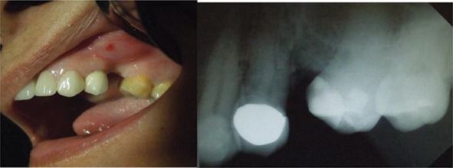
Cone beam scan application in dental implant therapy
Part of the advancement in dental implantology care is represented by the use of cone beam CT scan (CBCT), the three-dimensional orientation is the key to success.
A missing left second premolar that is challenged horizontally by crown tilting and pneumatized maxillary sinus.

Slide 17
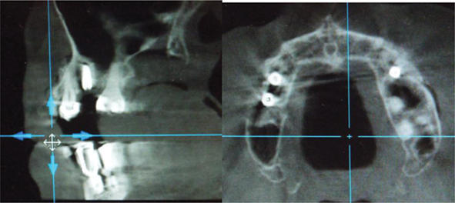
A postoperative CBCT scan shows the previous case of proper implant location that is not violating the sinus or dental structures as confirmed by parasagittal and axial views.

Slide 18
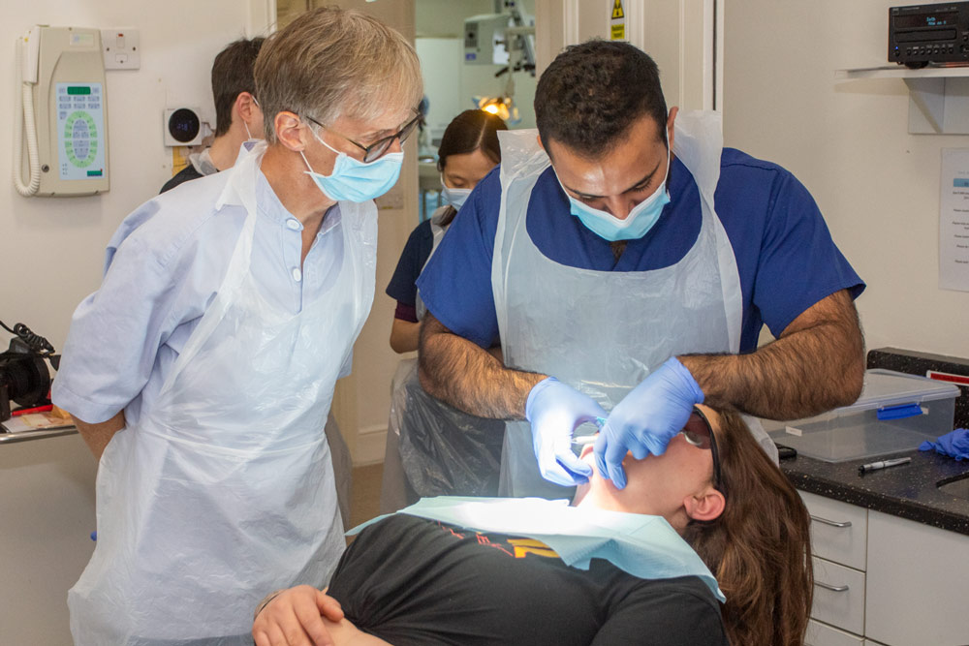
Cases

Slide 19
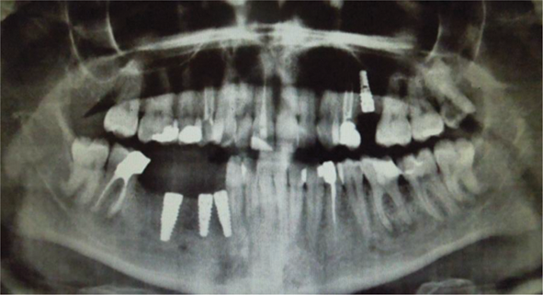
A panoramic radiograph showing three implants placed at the right mandible region. The implants are placed at improper locations pertinent to each other, surrounding structure, future rehabilitation, and opposing occlusion. Not using proper surgical stent to guide the future rehabilitation plan might lead to such devastating results.

Slide 20
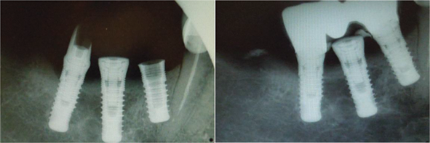
Three implants next to each other with improper relation pertinent to future rehabilitation and as a relation to the neighboring tooth structure.

Slide 21
Conclusion
As the dental implantology science is growing very fast, the demand to perfectionism is becoming more challenging. The technical advancement in dental and medical care is continuously improving and producing ideas…
…however, still a lot of doubts that one day technology might replace a human surgeon to operate on another human solely.

Slide 22
References:
Schlee M, and Esposito M (2009) Aesthetic and patient preference using a bone substitute to preserve extraction sockets under pontics
Barber HD, Betts NJ (1993) Rehabilitation of maxillofacial trauma patients with dental implants
Steiner GG, Francis W, Burrell R, Kallet MP, Steiner DM, Macias R (2008) The healing socket and socket regeneration
Sonick M, Hwang D (2007) Tooth extraction—an opportunity for site preservation. Contemp Esthetics
Smith LP, Ng M, Grubor D, Chandu A (2009) Outcomes of dental implants placed in a surgical training programme
Present S, Levine RA (2010). Single maxillary tooth restoration
Peter K (2004) Alveolar ridge reconstruction with preprosthetic surgery
Manikandan R, et al (2013) Implant surgical guide
Su-Gwan Kim (2011). Clinical Complications of Dental Implants, Implant Dentistry - A Rapidly Evolving Practice

Slide 23
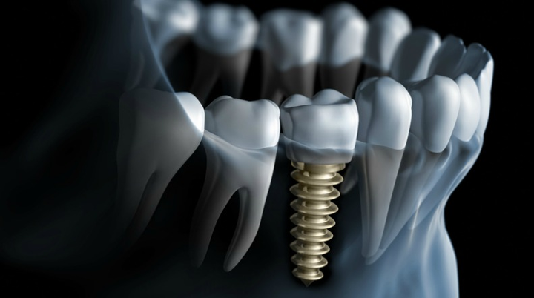
Thank you for the attention!

